Slide 1
Chapter 4: Threads (7th Edition) (Sharmin Afrose) Ref: NAT

Slide 2
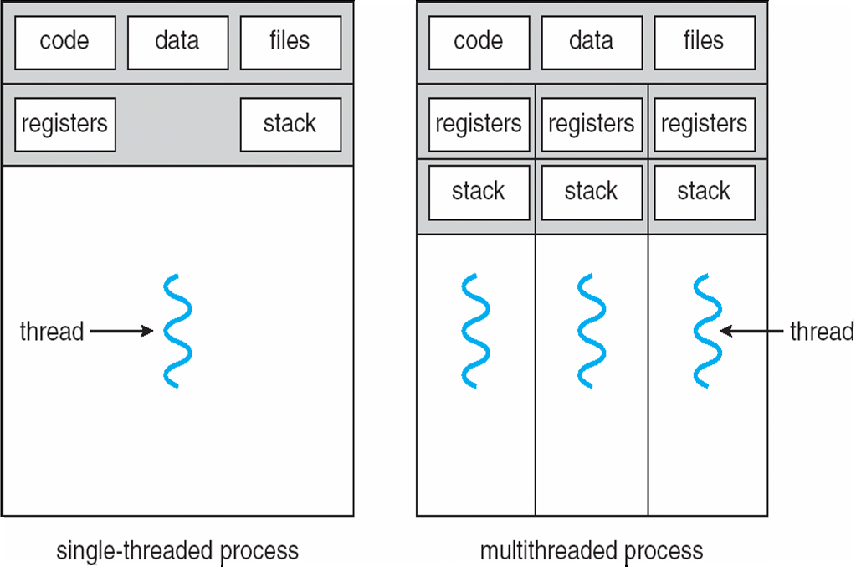
Single and Multithreaded Processes

Slide 3
For example in a word processor, a background thread may check spelling and grammar while a foreground thread processes user input ( keystrokes ), while yet a third thread loads images from the hard drive, and a fourth does periodic automatic backups of the file being edited.

Slide 4
Benefits
Responsiveness – may allow continued execution if part of process is blocked, especially important for user interfaces
Resource Sharing – threads share resources of process, easier than shared memory or message passing
Economy – cheaper than process creation, thread switching lower overhead than context switching
Scalability – process can take advantage of multiprocessor architectures

Slide 5
User Threads
User Thread : Support for thread may be provided at user level

Slide 6
Kernel Threads
Supported by the Kernel
Examples
Windows XP/2000
Solaris
Linux
Tru64 UNIX
Mac OS X
There must exists a relationship between user thread and kernel thread.

Slide 7
Multithreading Models
Many-to-One
One-to-One
Many-to-Many

Slide 8
Many-to-One
Many user-level threads mapped to single kernel thread
Examples:
Solaris Green Threads
GNU Portable Threads
Many to one model maps many user level threads to one Kernel level thread. Thread management is done in user space. When thread makes a blocking system call, the entire process will be blocks. Only one thread can access the Kernel at a time, so multiple threads are unable to run in parallel on multiprocessors.
If the user level thread libraries are implemented in the operating system in such a way that system does not support them then Kernel threads use the many to one relationship modes.

Slide 9
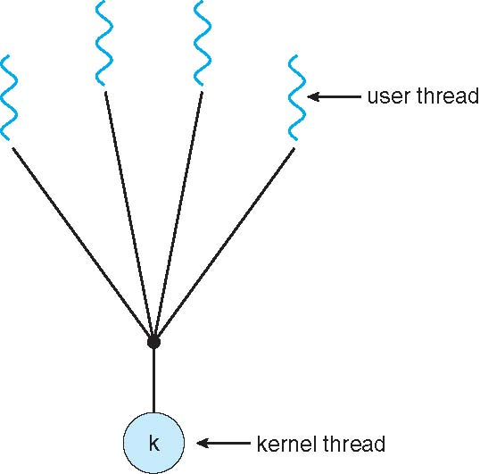
Many-to-One Model

Slide 10
One-to-One
Each user-level thread maps to kernel thread
Examples
Windows NT/XP/2000
Linux
Solaris 9 and later
There is one to one relationship of user level thread to the kernel level thread.This model provides more concurrency than the many to one model. It also another thread to run when a thread makes a blocking system call. It support multiple thread to execute in parallel on microprocessors.

Slide 11
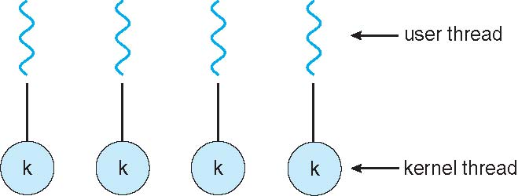
One-to-one Model

Slide 12
Many-to-Many Model
In this model, many user level threads multiplexes to the Kernel thread of smaller or equal numbers. The number of Kernel threads may be specific to either a particular application or a particular machine.
Following diagram shows the many to many model. In this model, developers can create as many user threads as necessary and the corresponding Kernel threads can run in parallels on a multiprocessor.
Solaris prior to version 9
Solaris is a good example of this combined approach. In a combined system, multiple threads within the same application can run in parallel on multiple processors and a blocking system call need not block the entire process.

Slide 13
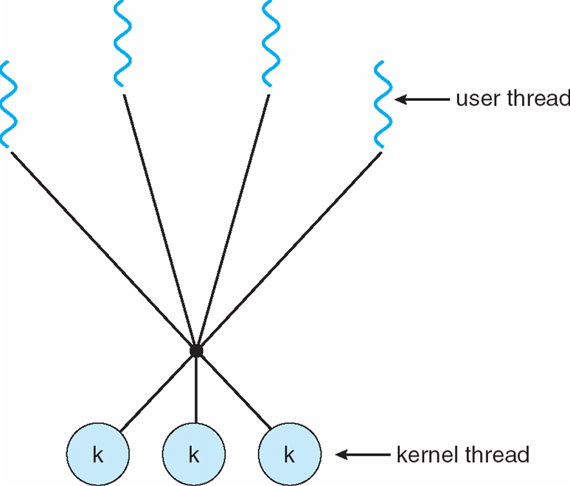
Many-to-Many Model

Slide 14
Thread Libraries
Provides the programmer and API for creating and managing threads.
Three primary thread libraries:
POSIX Pthreads
Win32 threads
Java threads

Slide 15
Threading Issues
Thread cancellation of target thread (page 139)
Asynchronous Cancellation
Deferred Cancellation
Signal handling (page 139)
All signals, whether synchronous or asynchronous, follows the same pattern :
A signal is generated by the occurrence of a particular event.
A generated signal is delivered to a process
Once delivered, the signal must be handled.

Slide 16
Thread Cancellation
Terminating a thread before it has finished
Two general approaches:
Asynchronous cancellation terminates the target thread immediately
Deferred cancellation allows the target thread to periodically check if it should be cancelled

Slide 17
Signal handling
Synchronous and asynchronous received signal.
Every Signal may be handled by one of two possible handlers:
A default signal handler
A user-defined signal handler

Slide 18
End of Chapter 4

